Slide 1

Predictive Analysis

Slide 2
Objectives
Use your machine learning skills to build a predictive model to help a business function more efficiently.
Testing differences mode:
  Logistic Regression
  Support Vector machines,
  Decision Tree Classifier
  K-nearest neighbors
Predictive Analysis

Slide 3
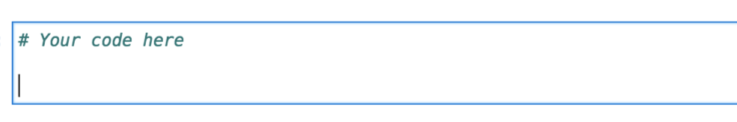
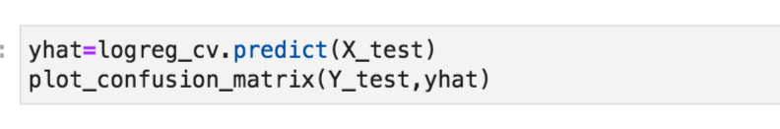
TASK5: Calculate the accuracy
Calculate the accuracy on the test data using the method score:
Predictive Analysis

Slide 4
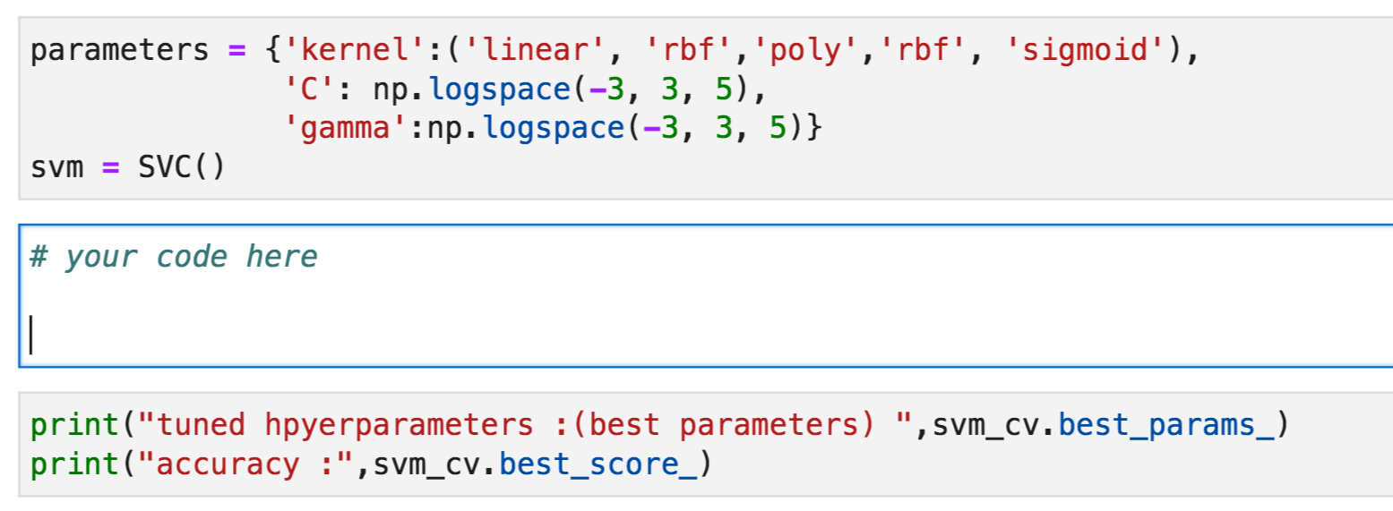

TASK6: find the best parameters
Create a support vector machine object then create a GridSearchCV object svm_cv with cv - 10.
Fit the object to find the best parameters from the dictionary parameters.
Predictive Analysis
Notes:
Examining the confusion matrix, we see that logistic regression can distinguish between the different classes. We see that the major problem is false positives.

Slide 5
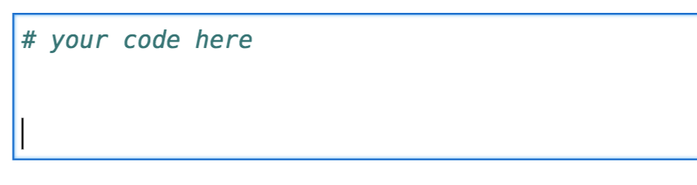
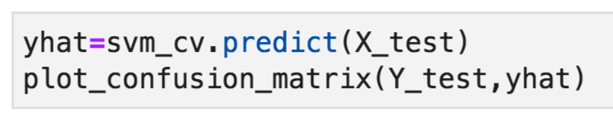
TASK7: Calculate the accuracy
Calculate the accuracy on the test data using the method score
Predictive Analysis

Slide 6
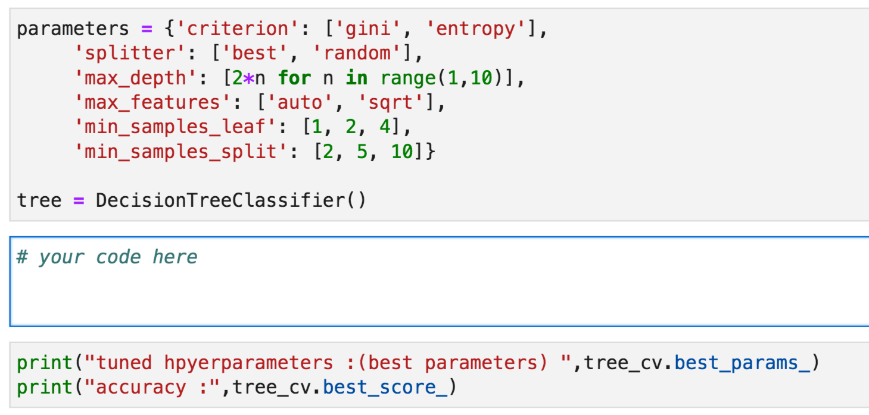
TASK8: find the best parameters
Create a decision tree classifier object then create a GridSearchCV object tree_cv with cv = 10.
Fit the object to find the best parameters from the dictionary parameters.
Predictive Analysis

Slide 7
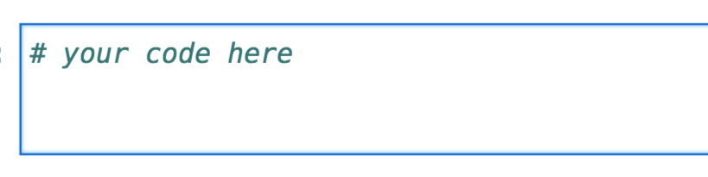
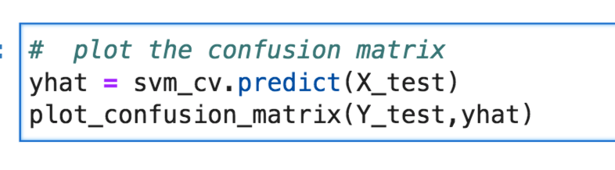
TASK9: Calculate the accuracy
Calculate the accuracy of tree_cv on the test data using the method score:
Predictive Analysis

Slide 8
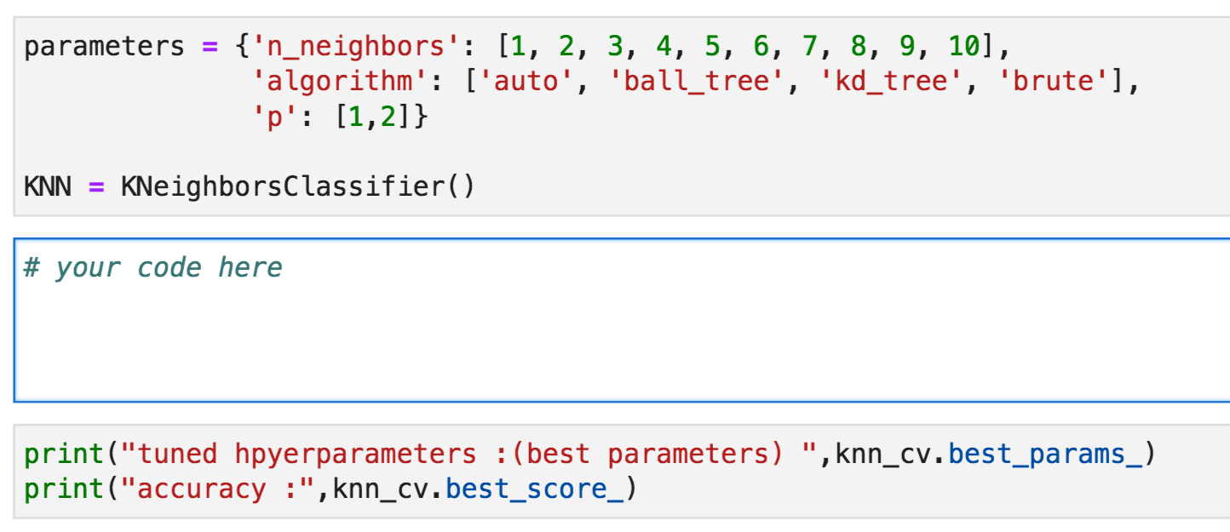
TASK10-find the best parameters
Create a k nearest neighbors object then create a GridSearchCV object knn_cv with cv = 10.
Fit the object to find the best parameters from the dictionary parameters.
Predictive Analysis

Slide 9
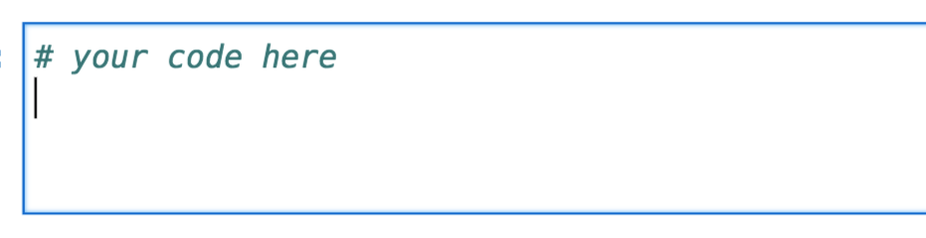
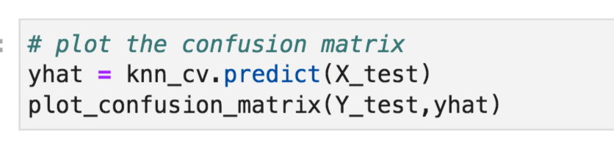
TASK11: Calculate the accuracy
Calculate the accuracy of tree_cv on the test data using the method score:
Predictive Analysis

Slide 10
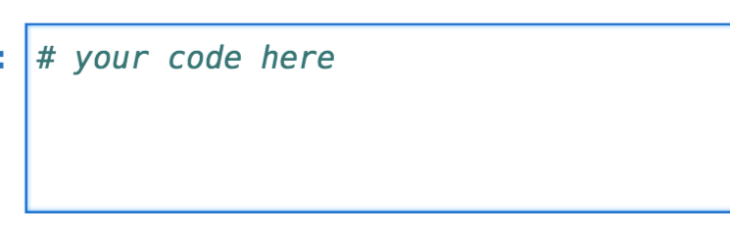
TASK12: find the best method
Find the method performs best:
Predictive Analysis

Slide 11
Summary
Use your machine learning skills to build a predictive model to help a business function more efficiently.
Testing differences mode:
  Logistic Regression
  Support Vector machines,
  Decision Tree Classifier
  K-nearest neighbors
Predictive Analysis

Slide 12
Q & A
Predictive Analysis

